Slide 1

MALLAREDDY TECHNICAL CAMPUS
NAME :
G Manisha
B Harshitha
CH Sruthi
K Anjana
Topic: ONLINE SHOPPING PRODUCT OPTIMIZER
Roll numbers:
25MVCSMR0122
25MVCSMR0106
25MVCSMR0109
25MVCSMR0135

Slide 2
Online Shopping Product Optimizer
Choose products under a budget while maximizing user-defined value.
Core Algorithms: 0/1 Knapsack Algorithm and Sorting Techniques
Suggested Technologies: HTML, CSS, JavaScript, Python/Flask, SQLite

Slide 3
Problem Statement & Objective
Problem Statement: Customers have many products to choose from but a limited budget.
The system helps select the most valuable combination without exceeding the budget.
Objectives:
• Accept the user's available budget.
• Store price, rating, discount, and utility.
• Calculate product value.
• Select products providing maximum value within the budget.
• Display selected products and total cost.
• Help users make faster and more informed shopping decisions.
• Example: For a ₹5,000 budget, select products whose total price is ≤ ₹5,000 while maximizing the preferred value.

Slide 4
Input, Output & Data Structure
Input: Product name, price, rating, discount, utility/value score, total budget, and preferred optimization factor.
Data Representation: Product = {Name, Price, Rating, Discount, Utility}
Product | Price | Rating | Discount | Utility
Headphones | ₹2,000 | 4.5 | 20% | 85
Smart Watch | ₹3,000 | 4.2 | 15% | 80
Keyboard | ₹1,500 | 4.6 | 10% | 75

Slide 5
Algorithms Used
1. 0/1 Knapsack Algorithm: Selects the best combination under a fixed budget. Price is the cost and utility is the value.
Formula: DP[i][w] = max(DP[i−1][w], value[i] + DP[i−1][w−price[i]])
2. Sorting: Products can be arranged by rating, price, discount, utility, or value-to-price ratio.

Slide 6
Working Process & Example
Workflow: User enters budget → Load products → Calculate value → Sort/rank → Apply Knapsack → Select combination → Display recommendations.
Example: Budget = ₹5,000
Product | Price | Utility
Headphones | ₹2,000 | 85
Keyboard | ₹1,500 | 75
Mouse | ₹1,000 | 60
Smart Watch | ₹3,000 | 80
Possible Selection: Headphones + Keyboard + Mouse | Total Cost: ₹4,500 | Remaining Budget: ₹500

Slide 7
Benefits & Future Scope
Benefits:
• Helps users stay within their budget.
• Provides personalized product recommendations.
• Maximizes utility, rating, or discount.
• Reduces manual product comparison.
• Makes shopping faster and easier.
• Demonstrates practical optimization algorithms.
Future Enhancements: AI recommendations
• Real-time prices •
Shopping API integration • Price comparison • User history • ML preferences • Mobile app
Conclusion: The system combines sorting and the 0/1 Knapsack algorithm to recommend products that provide maximum user-defined value while staying within a specified budget.

Slide 8
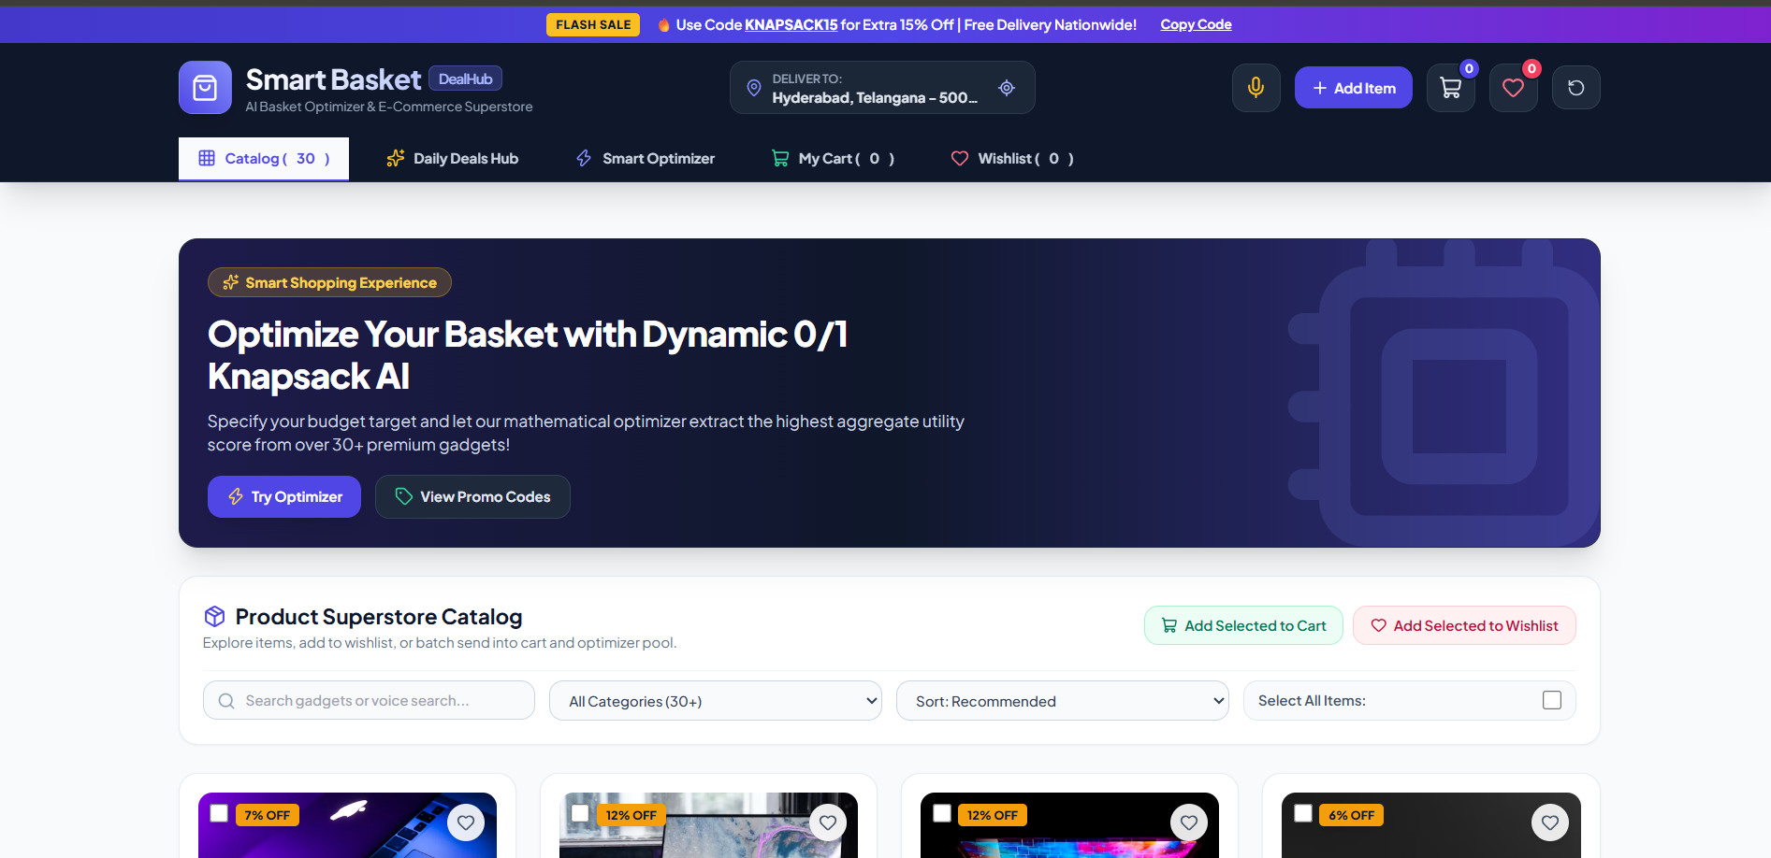
Output:

Slide 9
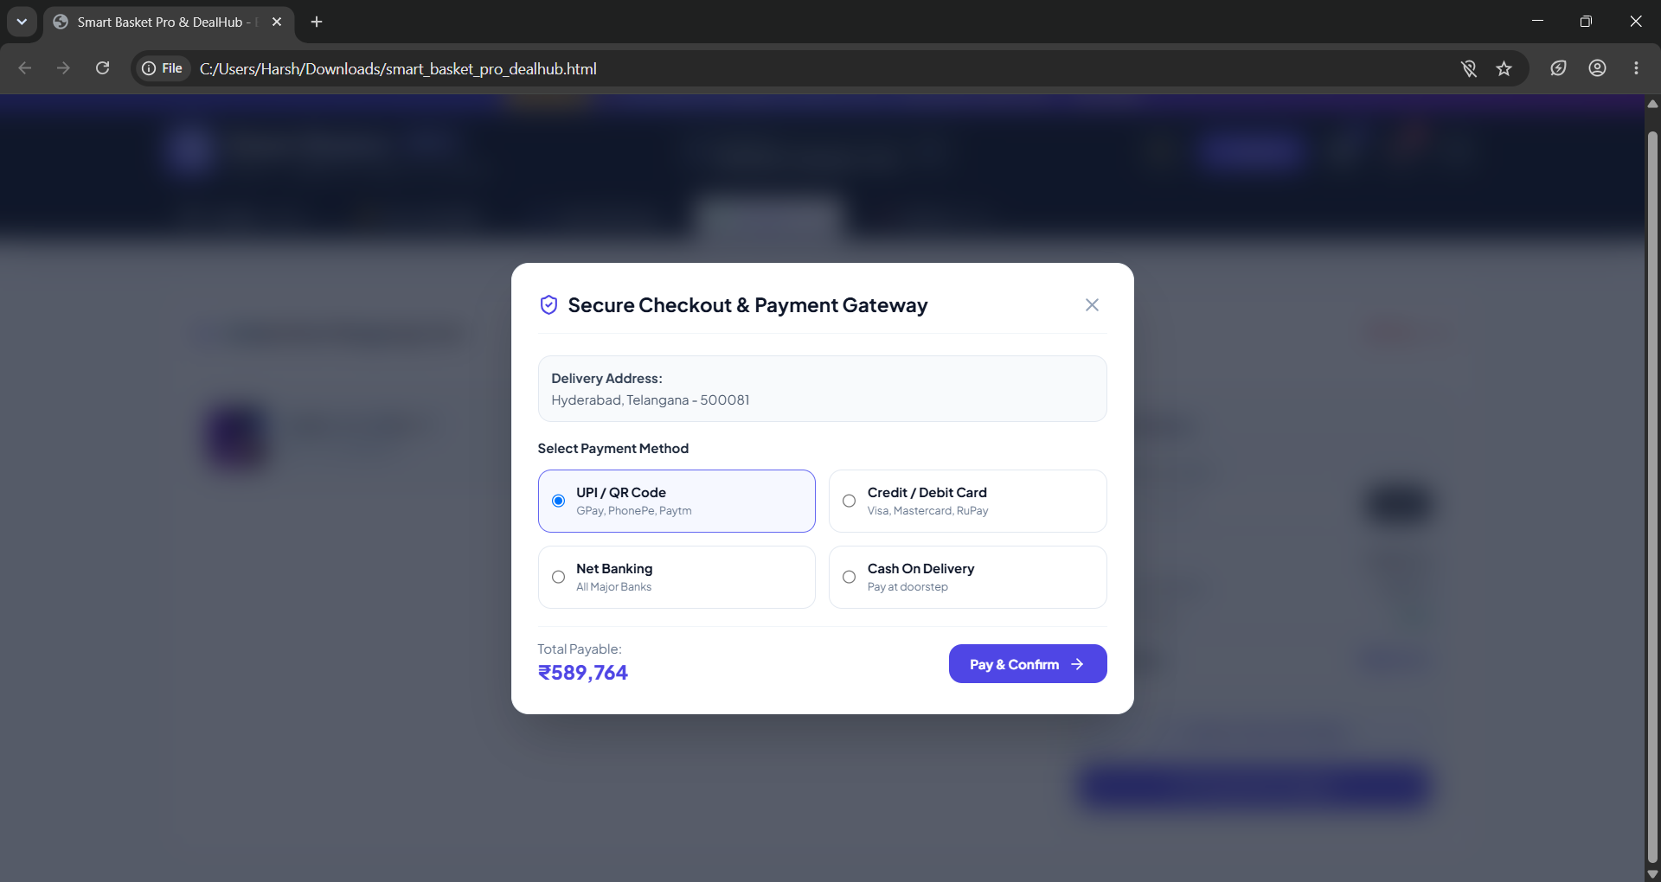

Slide 10
Thank you

